Slide 1
The Business Impact of AI Adoption
A Corporate Data Cleaning & Exploratory Data Analysis (EDA) Project
Analyzing 100K+ Corporate Observations (2015-2025) Presented by Rudra Pratap Singh

Slide 2
DATA CLEANING & EDA
Project Overview & Objectives
Project Scope
• Chronological Horizon: 2015 to 2025
• Industry Representation: 10 Distinct Sectors (Tech, Finance, Manufacturing, Retail, etc.)
• National Diversity: 15 Countries (USA, China, Singapore, Germany, Brazil, India, etc.)
• Target Population: 104,845 total corporate observations tracked over a decade.
Core Objectives
✔ Validate and Clean Raw Corporate Data: Check integrity, identify nulls/duplicates, and detect statistical anomalies.
✔ Perform Extensive EDA: Analyze trends, industry-specific adoption rates, and investment differences.
✔ Identify Growth Drivers: Highlight statistical correlations between training, maturity, automation, and performance.
✔ Provide Strategic Insights: Support business leaders in maximizing productivity and financial returns on AI.

Slide 3
DATA CLEANING & EDA
The Raw Dataset (What Data We Got)
Dataset Characteristics
Total Records: 104,845 rows
Total Features: 13 columns
Missing Values: 0 (100% complete)
Duplicates: 0 duplicate rows
Observation Years: 2015 – 2025
Variables & Metrics Captured
• company_id, industry, country (Identifiers & demographics)
• year, ai_adoption_level (Temporal tracking & adoption scale)
• ai_investment_usd (Financial input (USD))
• cost_savings, revenue_impact (Financial returns / outcomes)
• automation_rate, productivity_gain (Process and efficiency gains)
• employee_ai_training_hours (Human capital development input)
• ai_maturity_score, deployment_count (Capability maturity & scaling metrics)

Slide 4
DATA CLEANING & EDA
Data Cleaning & Preprocessing (Changes Made)
1. Data Validation
• Nulls Checked: Evaluated all columns using df.isnull().sum(). Zero missing values found.
• Duplicates Checked: Verified row integrity using df.duplicated().sum(). No duplicate rows present.
• Schema Verified: Confirmed correct data types (5 floats, 5 integers, 3 objects).
2. Categorical Audit
• Industry Categories: Audited all 10 unique industries for text inconsistencies. All standard.
• Country Demographics: Audited all 15 unique countries. Verified zero spelling variants or duplicates.
• Case Standardizing: Column names confirmed in consistent, lowercase snake_case.
3. Outlier Strategy
• Detection Method: Combined visual Box Plots with statistical Z-scores (abs(Z) > 3).
• Key Skew Columns: Financial features (Cost Savings, Revenue Impact, and Investment) showed high outlier counts.
• Analytical Decision: Outliers kept in the dataset. They represent real business variations (large enterprises) rather than errors.

Slide 5
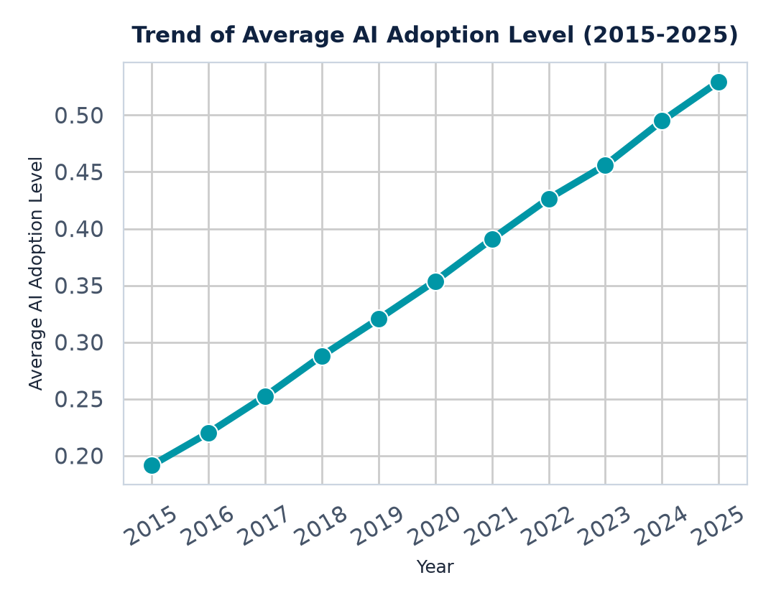
DATA CLEANING & EDA
Insights: AI Adoption Trends & Investments
Chart Analysis & Strategic Value
⚡ Steady 10-Year Growth: Average AI adoption level climbed from 0.19 (2015) to 0.53 (2025). This shows that corporate adoption of AI is not a short-term trend, but a continuous technological transition.
⚡ Financial Sector dominance: Financial Services records the highest average AI investment ($6.19M), while Technology ranks second ($4.92M). These high-resource industries lead the financial backing of AI adoption globally.
⚡ Unique Insight: AI adoption averages are nearly identical across all 10 industries (around 0.35-0.36), indicating that almost all sectors are attempting to adopt AI at a similar pace, despite vast differences in their financial budgets (e.g. Education invests only $0.61M average).

Slide 6
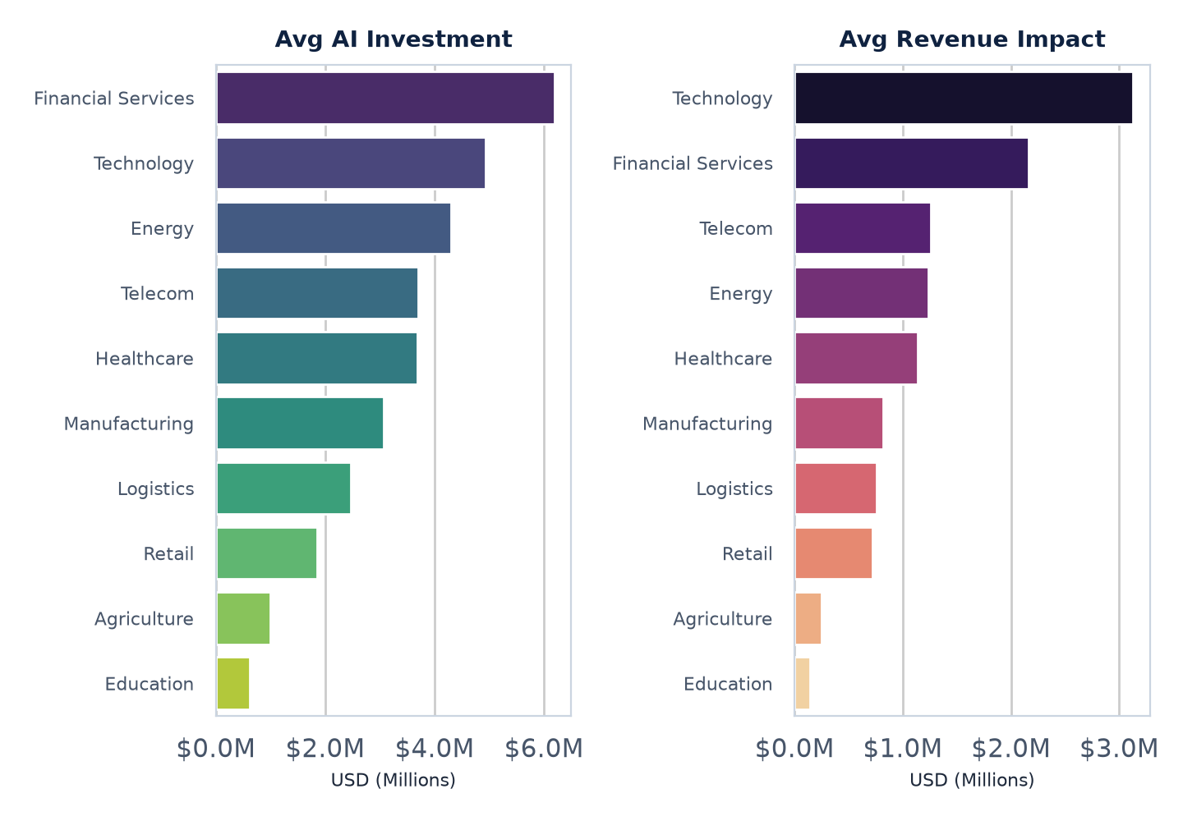
DATA CLEANING & EDA
Insights: Business Returns & Productivity
Financial Returns vs. Efficiency
⚡ Financial Returns: Technology achieves the highest revenue impact ($3.13M avg) and cost savings ($2.52M avg). Tech is structurally positioned to directly monetize AI capabilities.
⚡ Operational Productivity: Manufacturing and Logistics lead in productivity gains (average 0.30 gain). In these physical asset industries, AI automation of supply chains and factory scheduling yields immediate process efficiency.
⚡ Unique Insight: There is a divergence between who spends/gains the most money and who achieves the highest efficiency. Financial Services and Tech spend and generate the most cash, but Manufacturing and Logistics are the true winners in productivity gains.

Slide 7
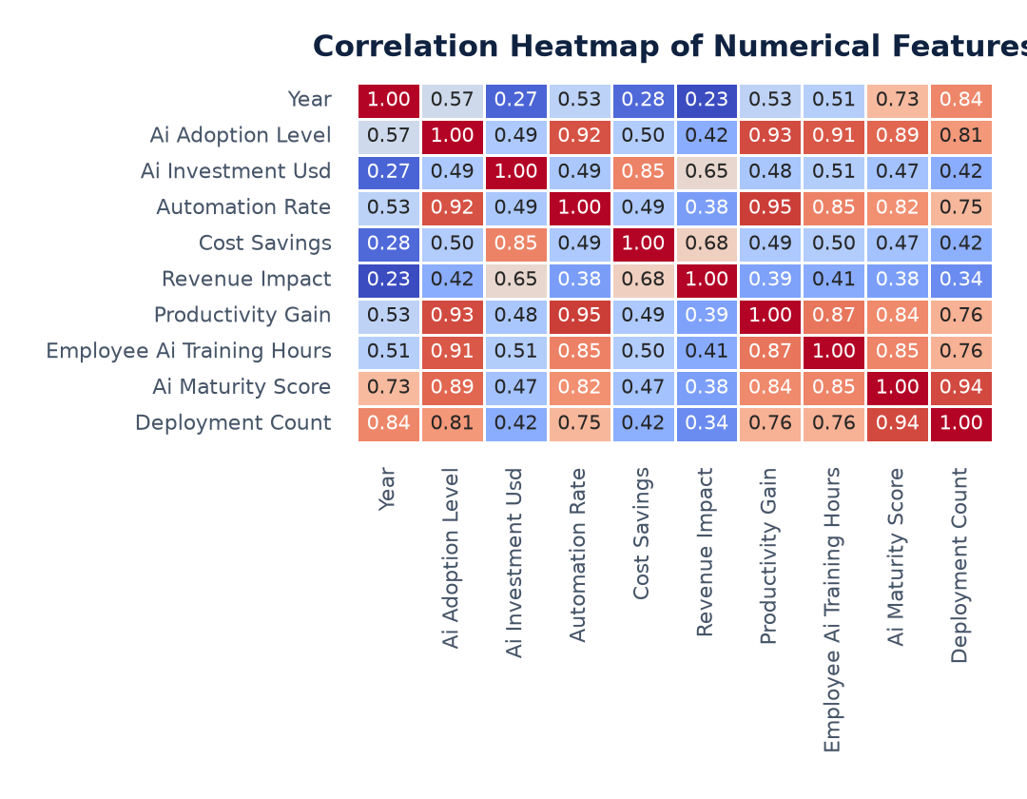
DATA CLEANING & EDA
Insights: Correlation & Key Growth Drivers
Correlation & Growth Engine Analysis
🔗 Automation is Key: Automation Rate and Productivity Gain have a correlation of 0.95. Automating workflows is the single most powerful driver of corporate productivity improvements.
🔗 Human Capital is the Catalyst: Employee AI Training hours correlate at 0.85 with AI Maturity Score. Companies that ignore training cannot achieve operational maturity.
🔗 Unique Insight: AI investment has a strong correlation with Cost Savings (0.85) but only a moderate correlation with Revenue Impact (0.65). This indicates that AI is initially much more effective as a tool for cutting costs than for building new revenue streams.

Slide 8
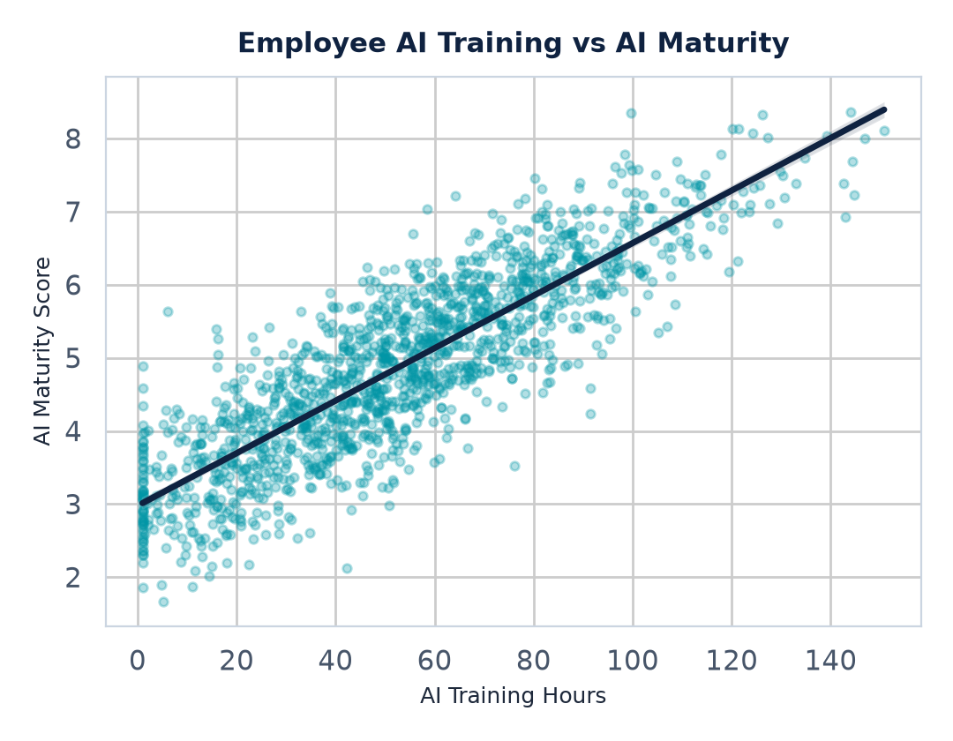
STRATEGIC RECOMMENDATIONS
Actionable Recommendations (Changes We Can Make)
Data-Driven Strategic Actions
1. Prioritize Workforce Reskilling: Since employee training has a strong positive relationship with AI maturity (r=0.85), reskilling programs must be structured and mandatory, not optional.
2. Focus on Process-Wide Integration: Siloed AI experiments yield poor returns. Organizations should integrate AI systematic tools directly into day-to-day operations to raise maturity scores.
3. Direct Budget to Automation: Prioritize AI investments that automate tasks, especially in logistics and supply chain systems, where the productivity payoff is mathematically highest (0.95 correlation).
4. Re-evaluate Education & Agriculture: Low investment and return sectors need tailored AI use cases (like AI teaching assistance or soil-specific crop intelligence) rather than standard corporate tools.

Slide 9
Conclusion & Future Analysis Scope
Project Summary
This project demonstrates that AI adoption is a powerful catalyst for corporate growth, scaling steadily from 2015 to 2025. It shows that financial gains (cost savings, revenue impact) and operational gains (productivity) are highly achievable but require structured investments in employee capability and maturity integration. High quality, thorough data cleaning guarantees that these insights are based on verified data.
Recommended Future Analysis for Your Report
• Risk & Failure Analysis: Build a dedicated sub-section analyzing underperforming firms (companies that recorded negative revenue impact or negative productivity gains).
• Outlier Sensitivity Checks: Since there are over 2,000 statistical outliers in cost/savings metrics, run a comparison of means and medians to check the skewness of financial metrics.
• Acknowledge Simulated Data: Add a brief footnote explaining that the uniform industry distributions suggest the dataset is synthetic, which explains the exceptionally clean correlations.

